Slide 1
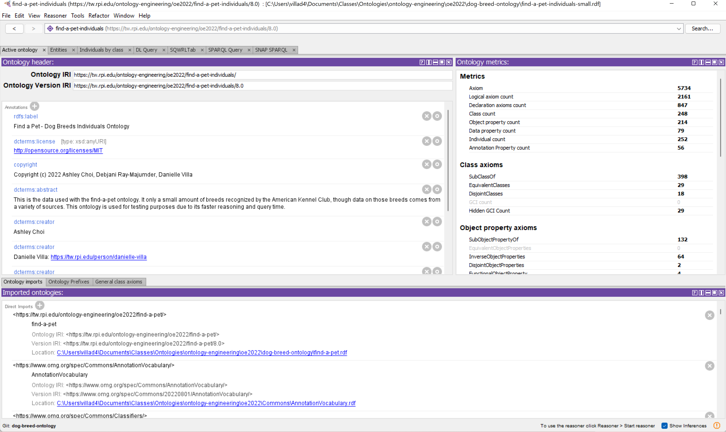
Load Ontology
Load the small individuals ontology into your triple store of choice (as long as it can use SNAP SPARQL), we use Protégé

Slide 2
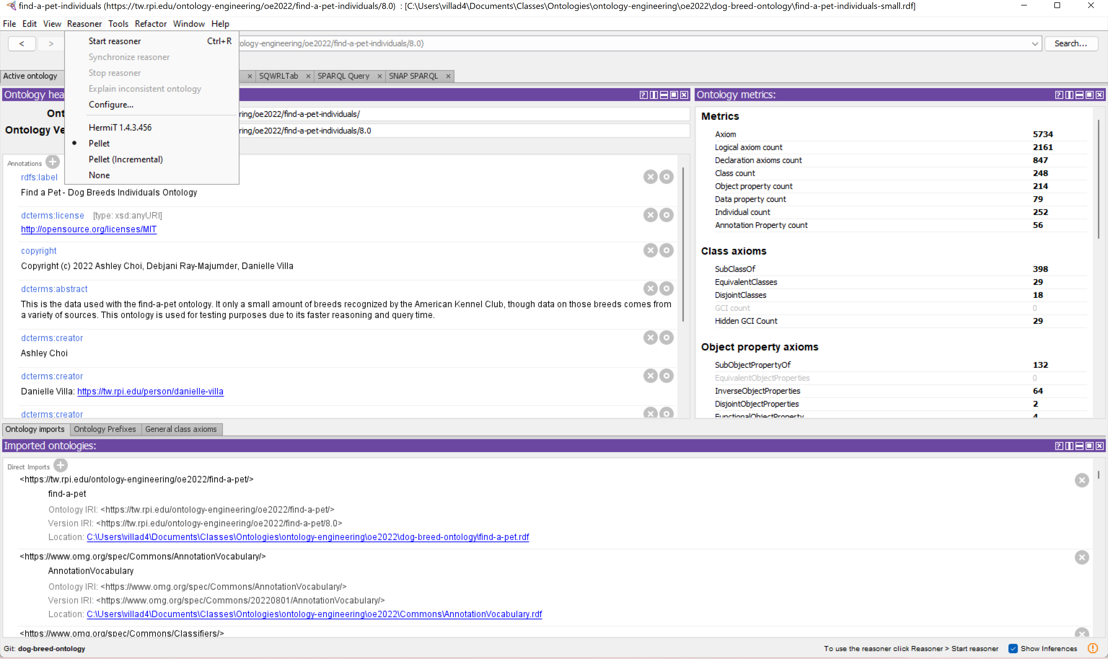
Run Reasoner
Run your reasoner of choice over the ontology. We used Pellet and it took ~20 min.

Slide 3
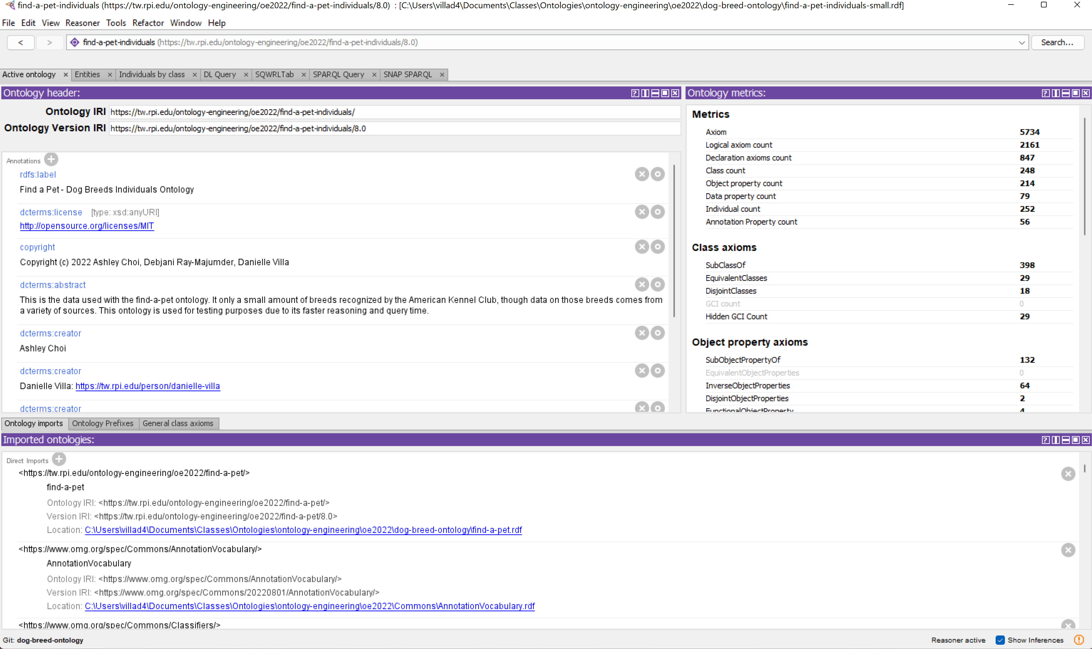
Use SNAP SPARQL
Open SNAP SPARQL

Slide 4
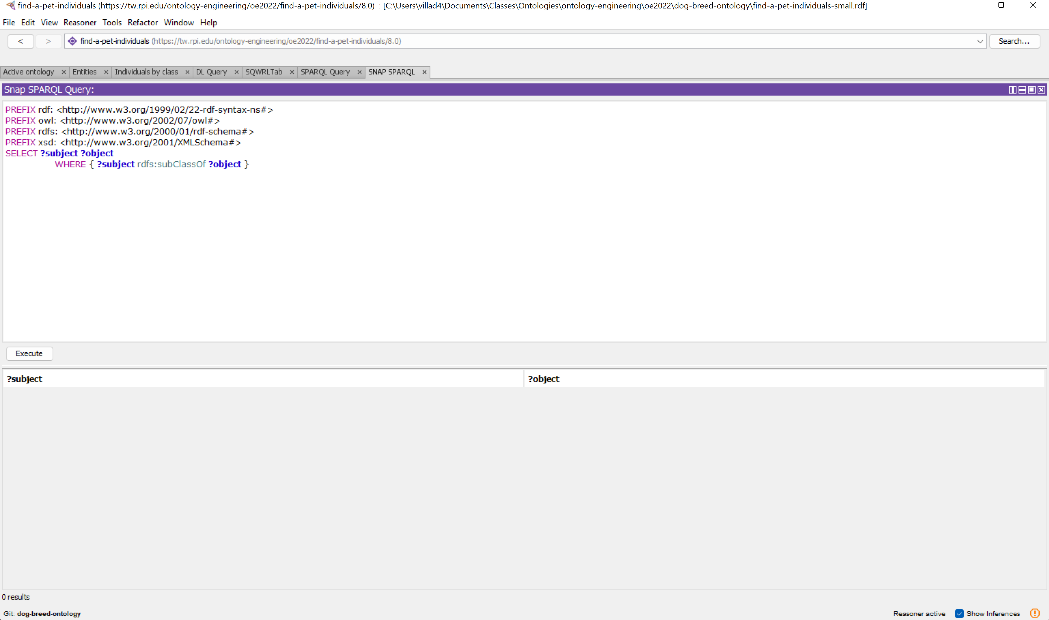
Use SNAP SPARQL

Slide 5
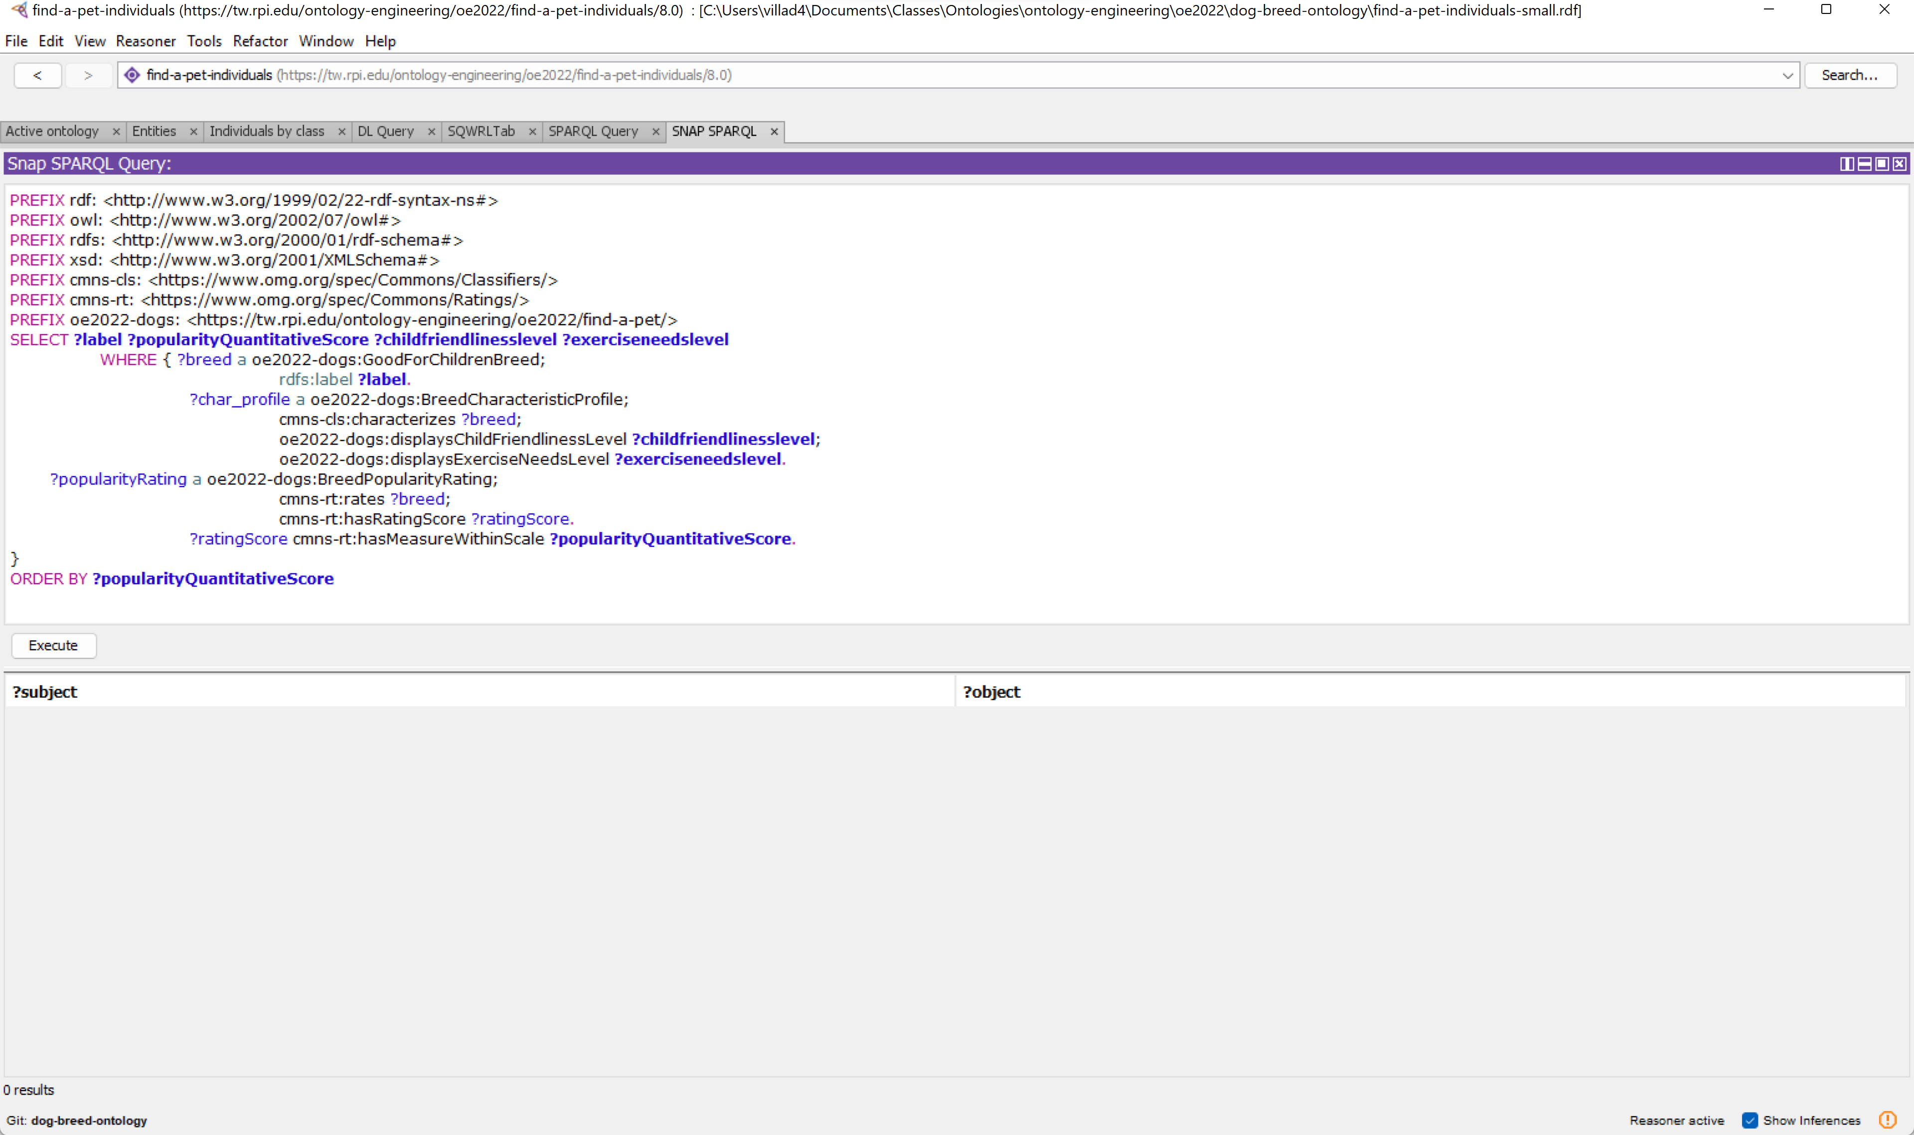
Query 1
Enter the first query

Slide 6
Execute

Slide 7
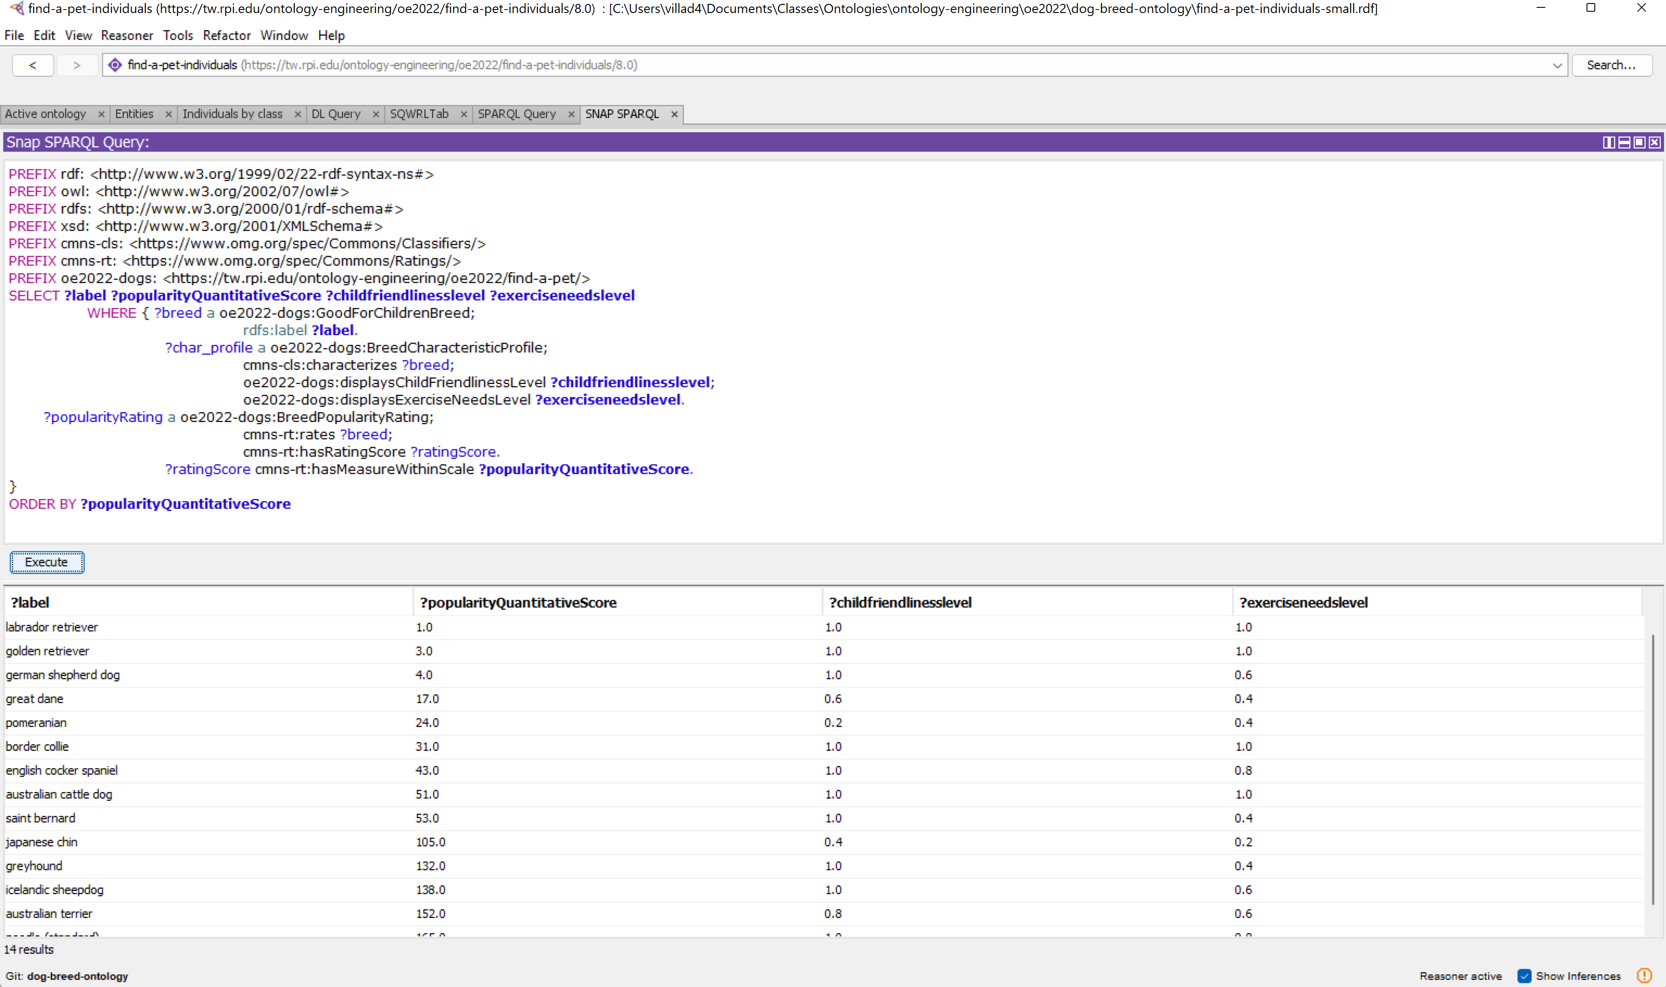
Results
Shown are the expected results

Slide 8
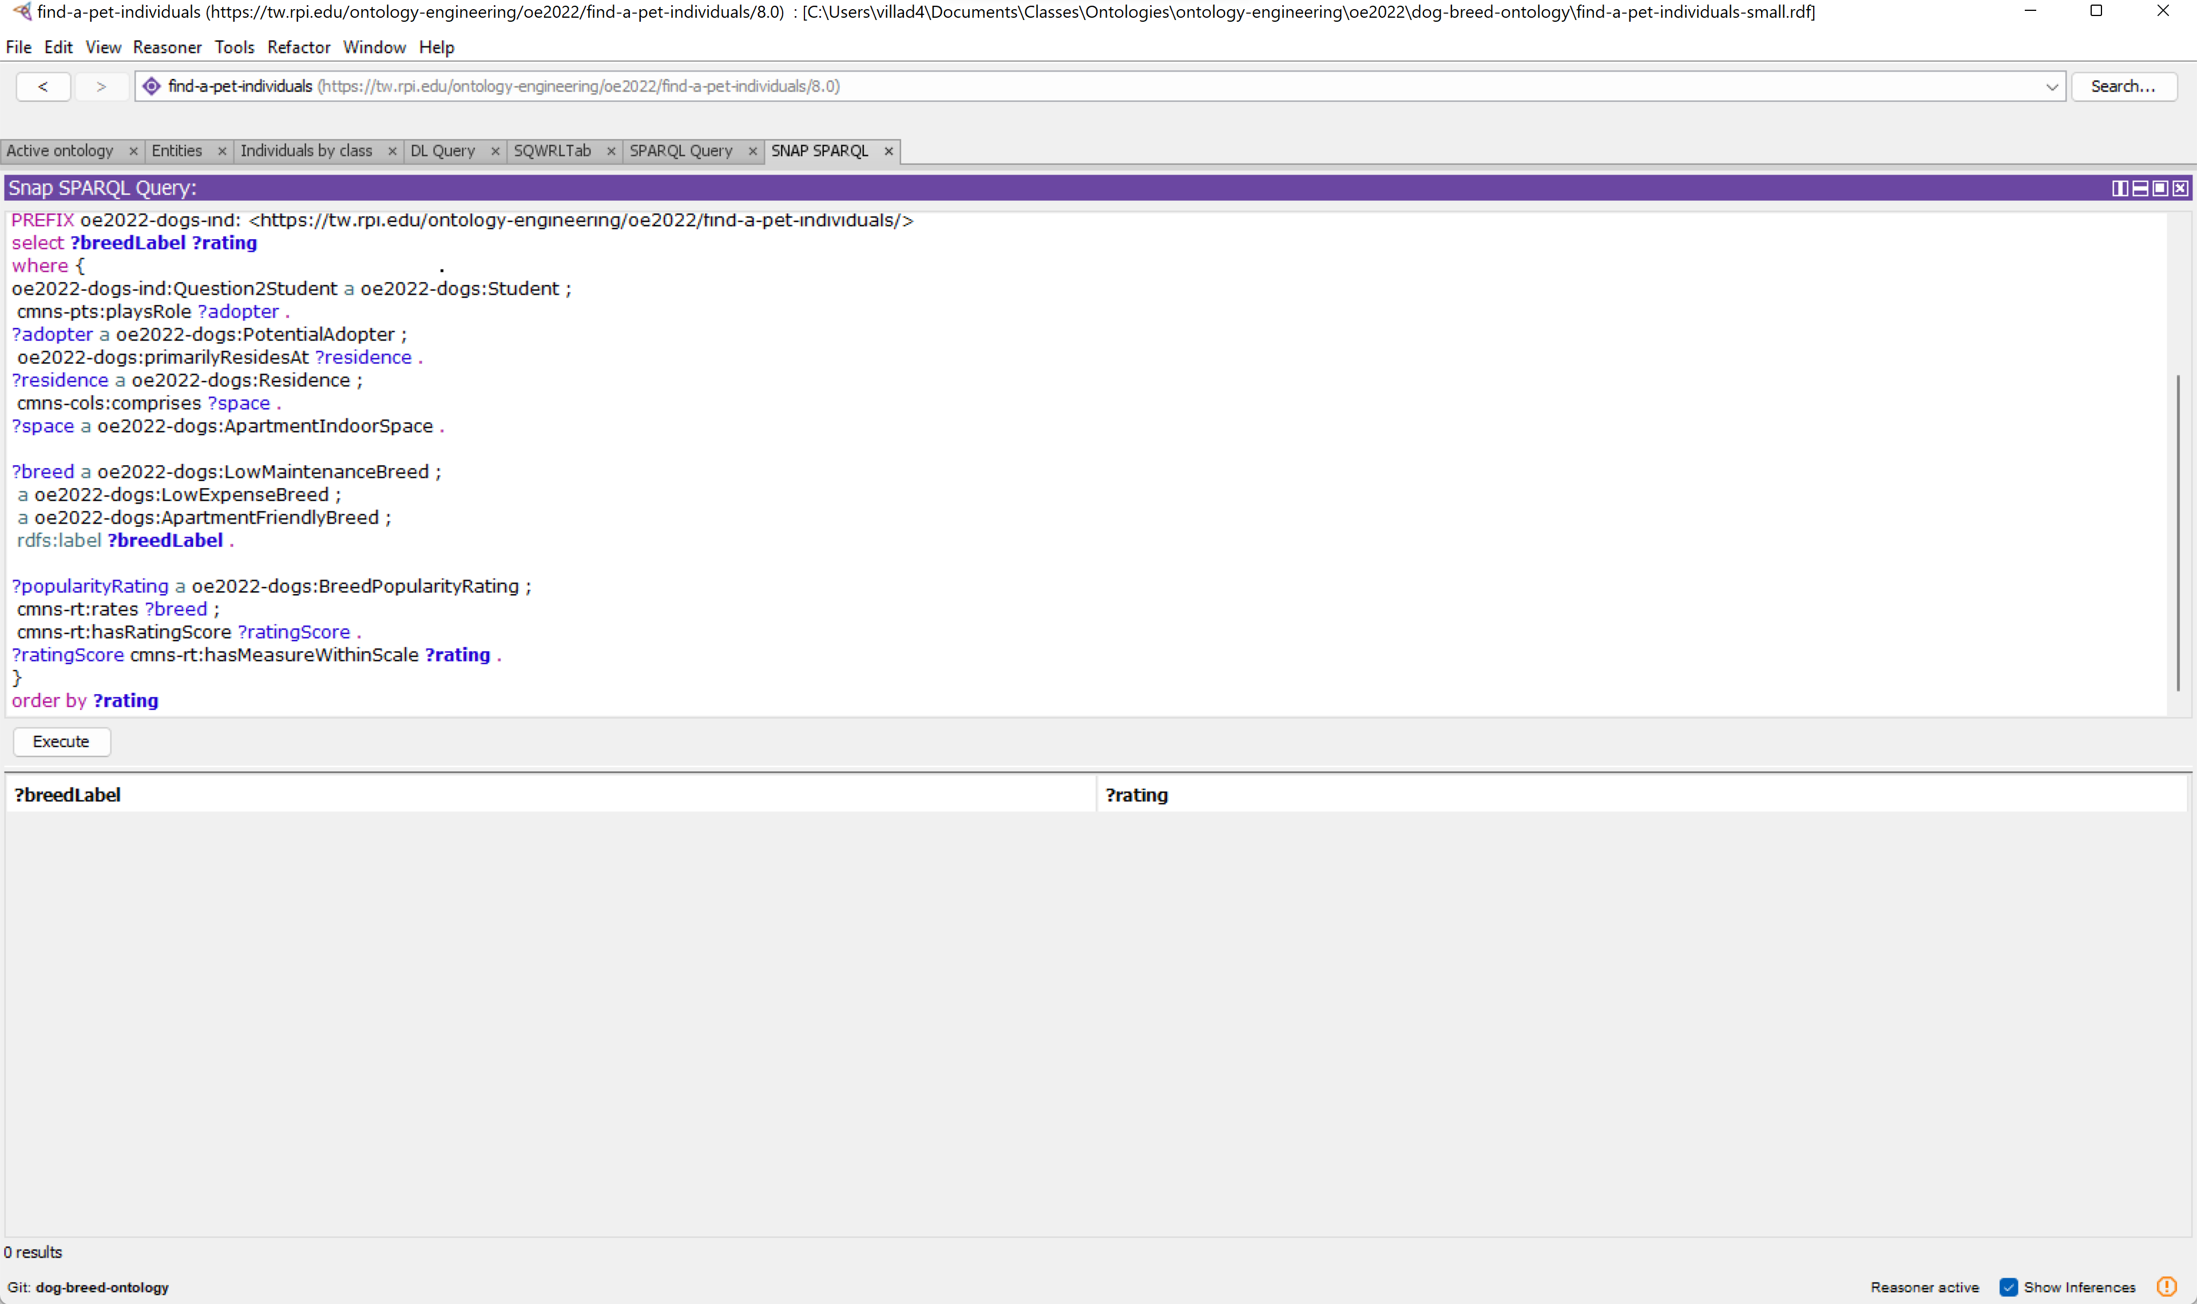
Query 2
Enter the second query

Slide 9
Execute

Slide 10
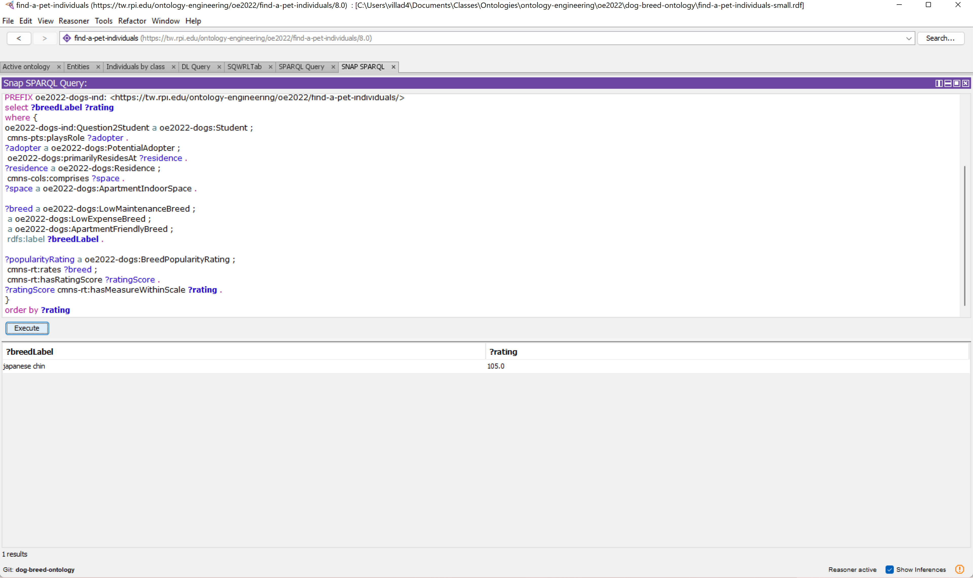
Results
Shown are the expected results

Slide 11
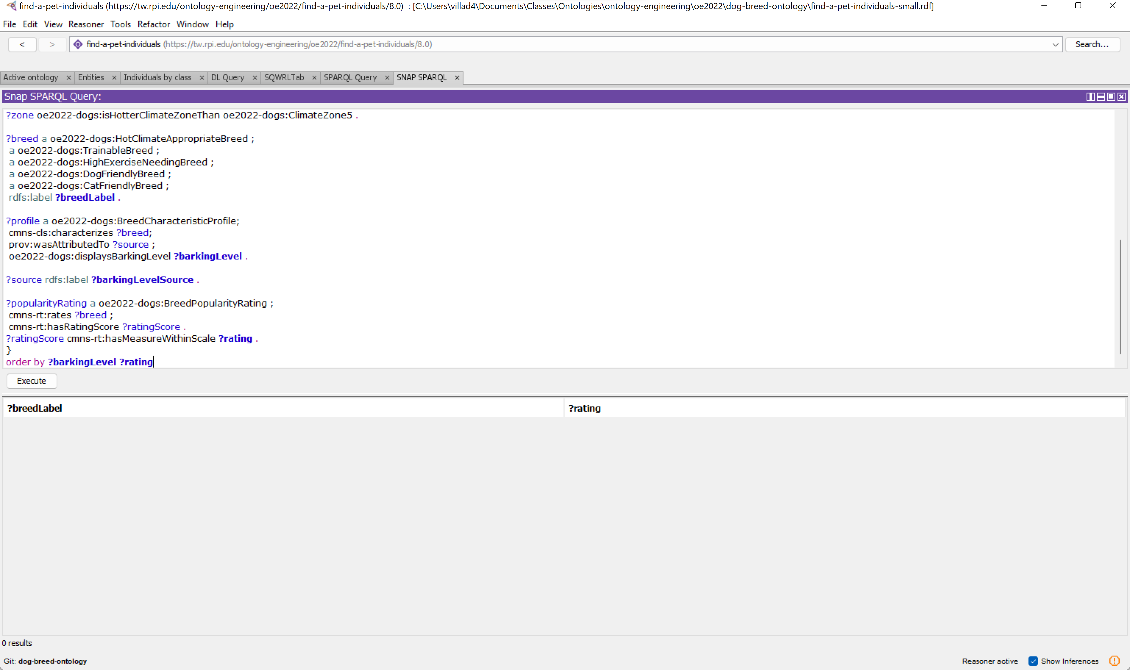
Query 3
Enter the third query

Slide 12
Execute

Slide 13
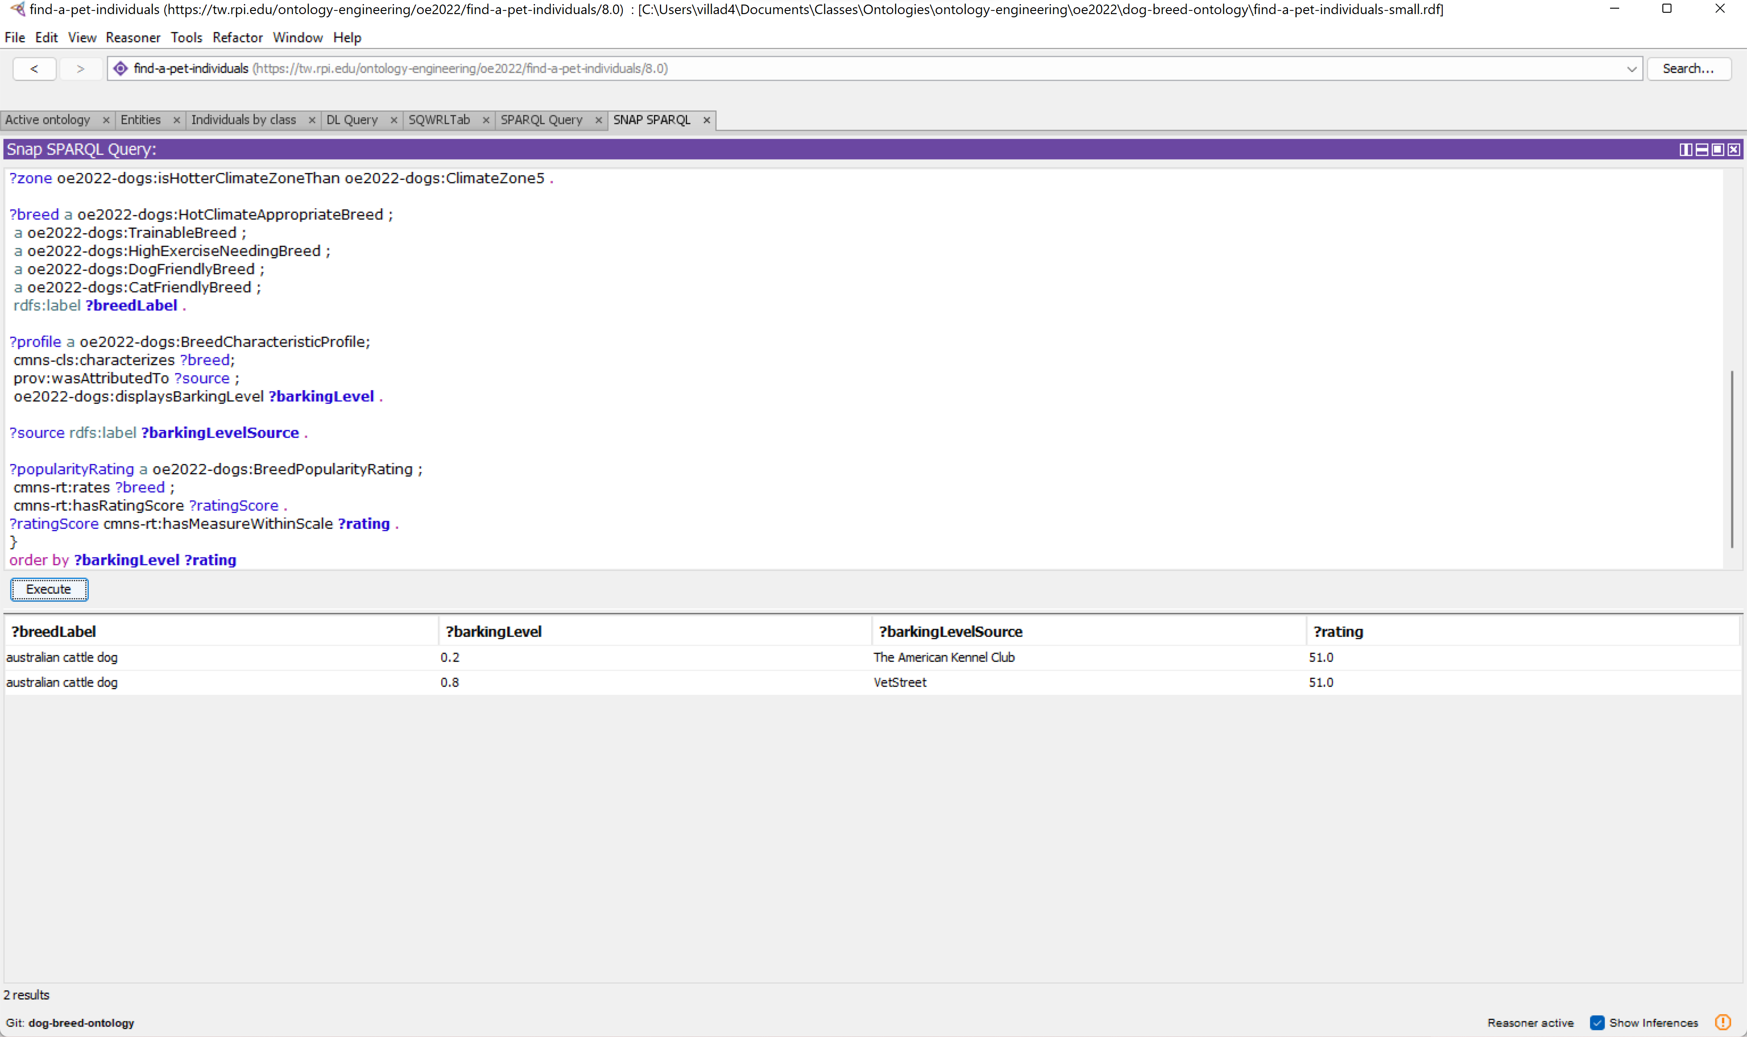
Results
Shown are the expected results

Slide 14
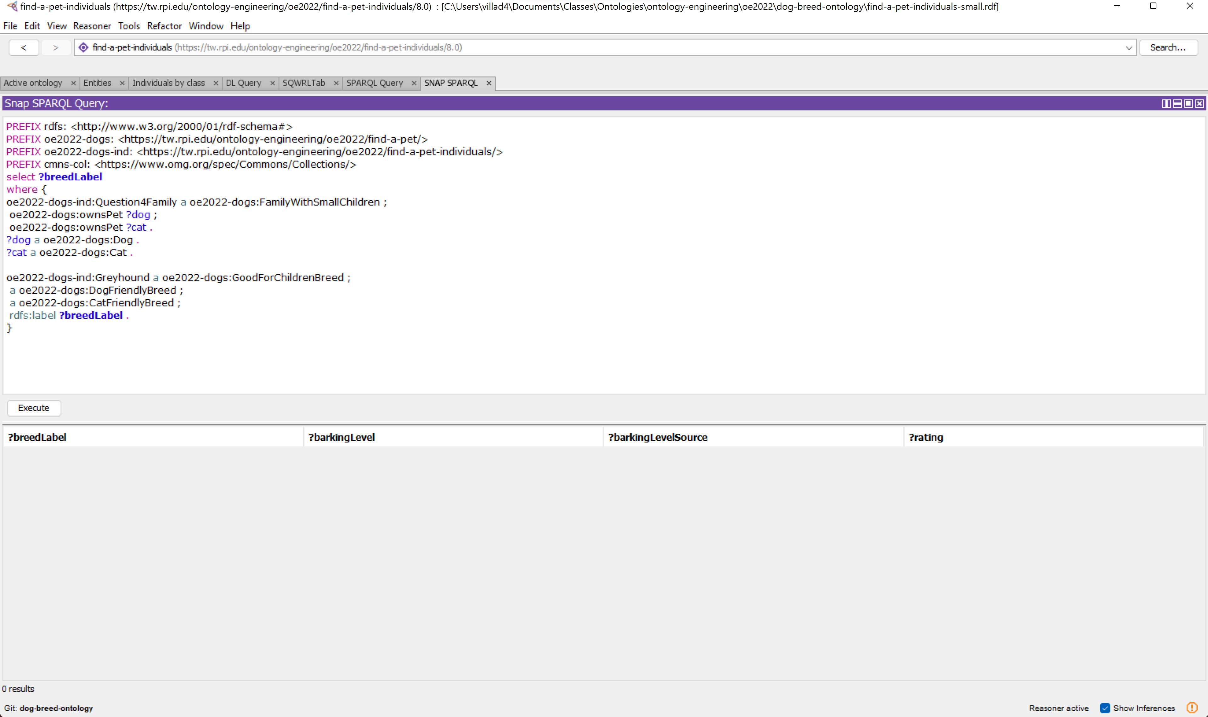
Query 4
Enter the fourth query

Slide 15
Execute

Slide 16
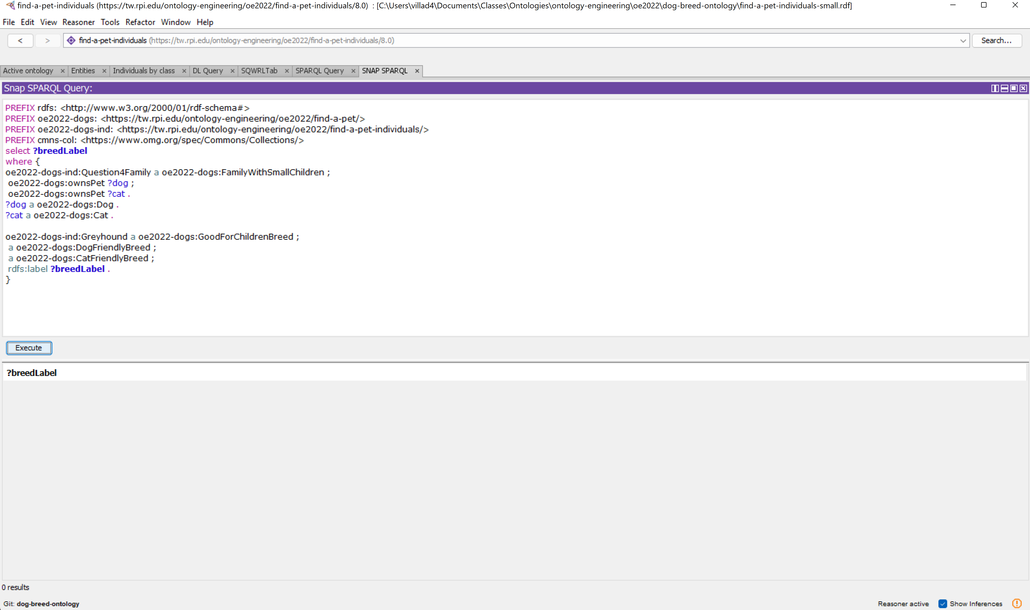
Results
Shown are the expected results, since a greyhound is not a good fit nothing is returned

Slide 17
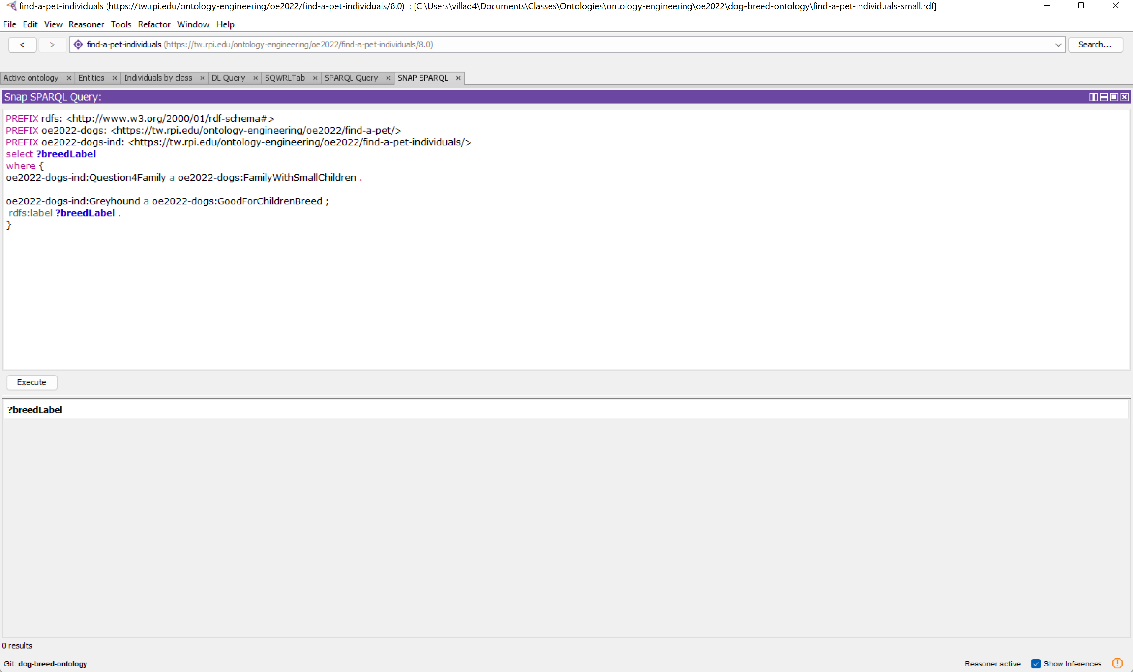
Alternate Query 4.1
Enter the first part of the alternate to the fourth query

Slide 18
Execute

Slide 19
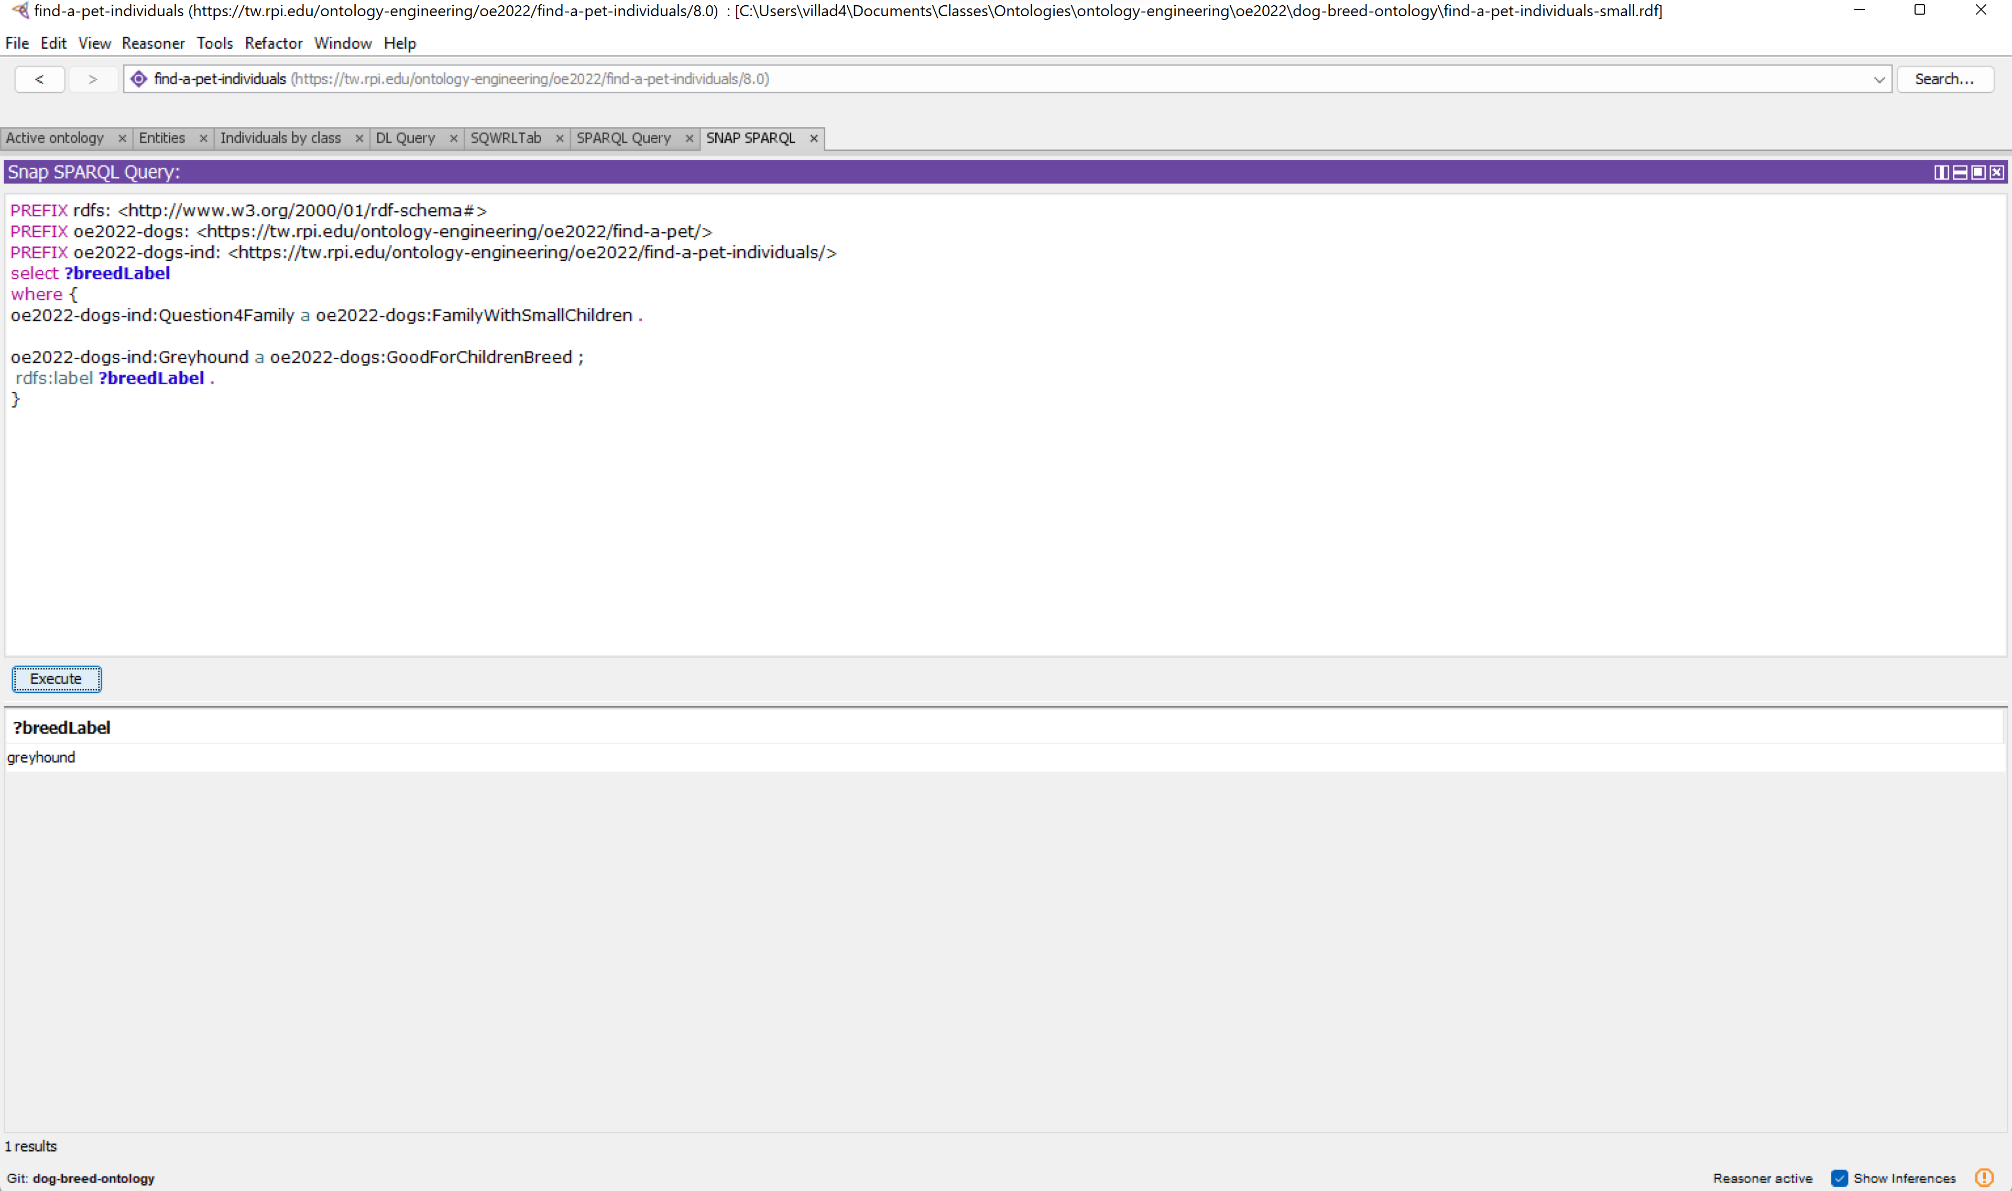
Results
Shown are the expected results, since greyhound is a breed that is good for children

Slide 20
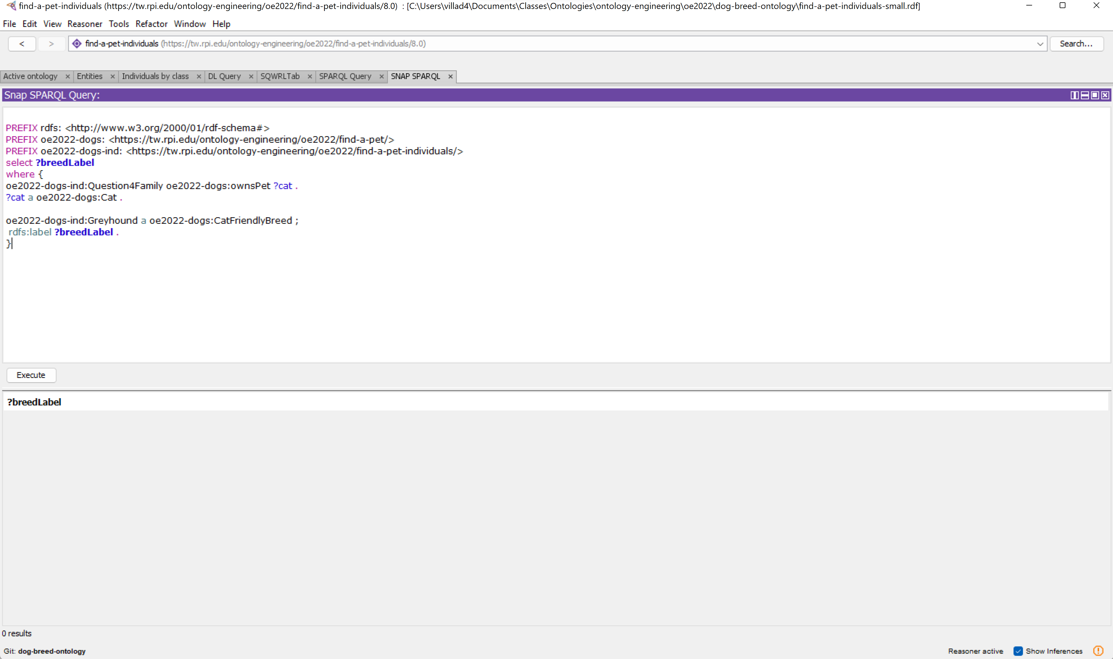
Alternate Query 4.2
Enter the second part of the alternate to the fourth query

Slide 21
Execute

Slide 22
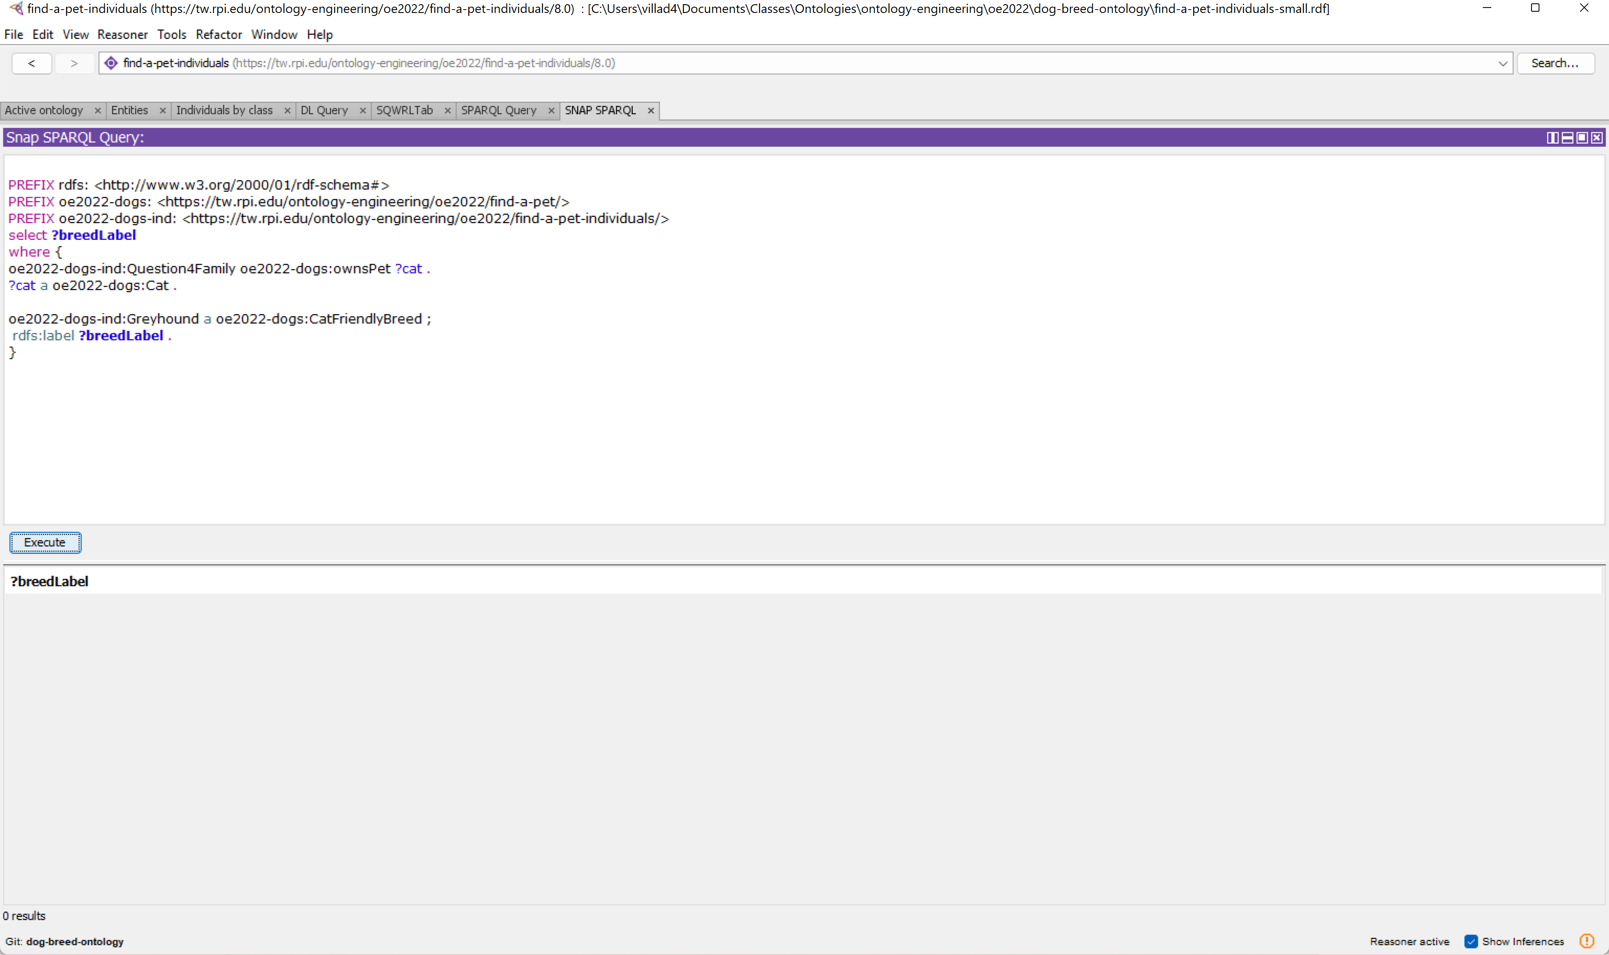
Results
Shown are the expected results, since greyhound is not a cat friendly breed

Slide 23
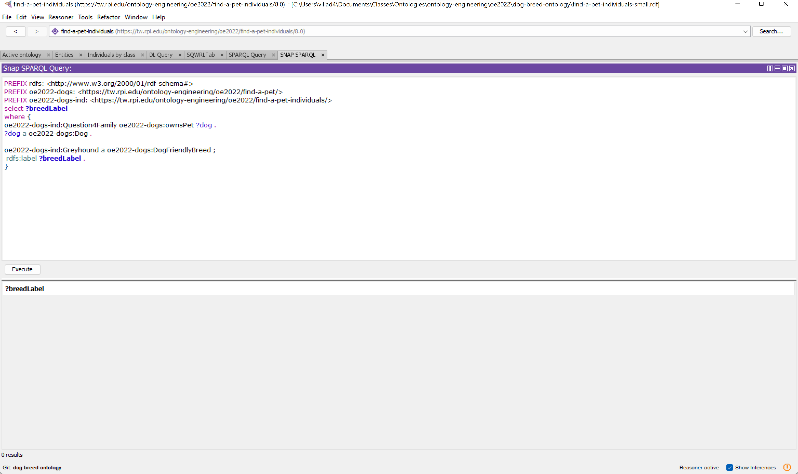
Alternate Query 4.3
Enter the third part of the alternate to the fourth query

Slide 24
Execute

Slide 25
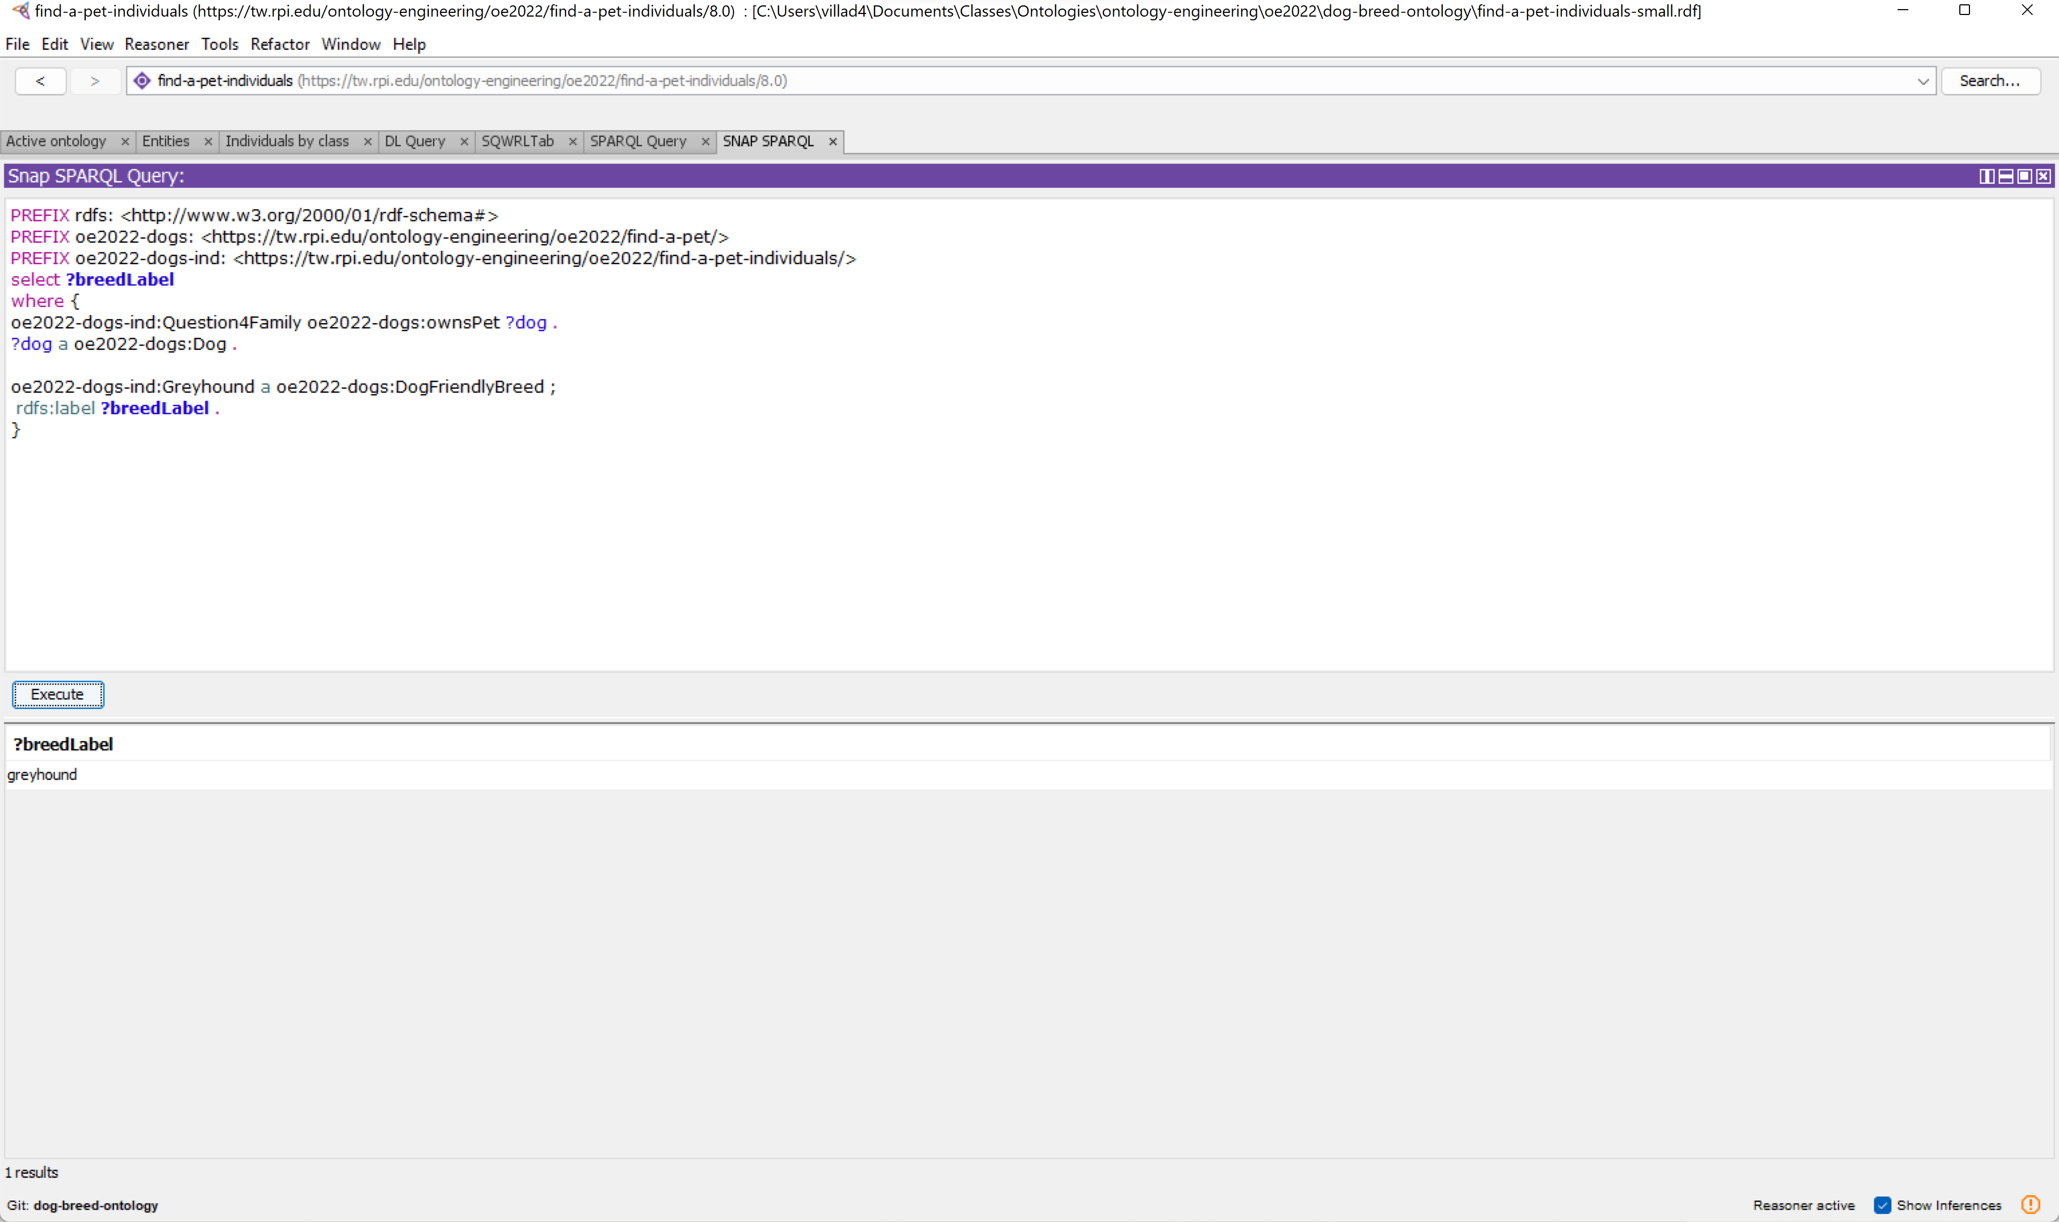
Results
Shown are the expected results, since greyhound is a dog friendly breed

Slide 26
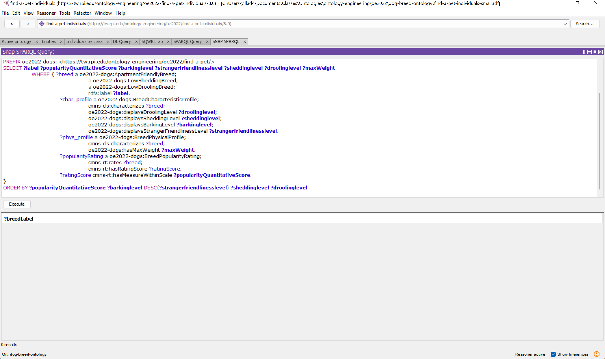
Query 5
Enter the fifth query

Slide 27
Execute

Slide 28
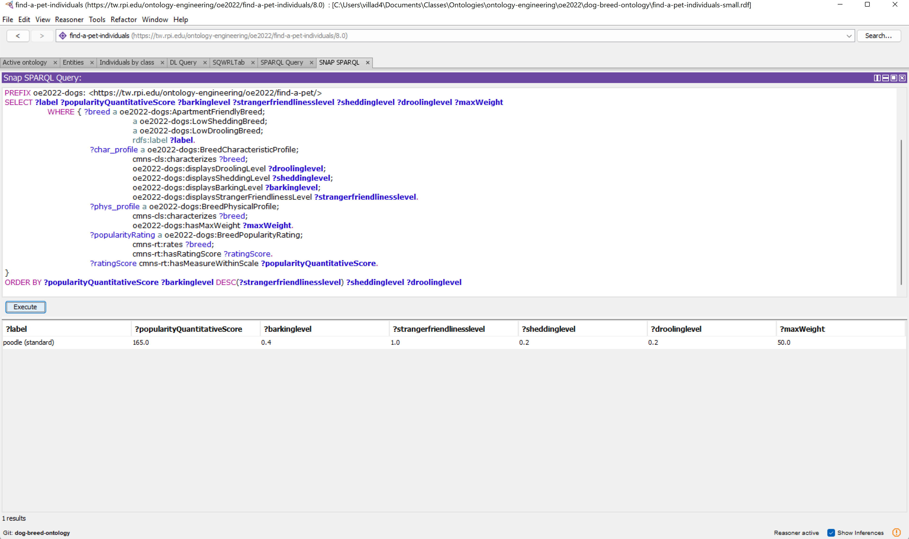
Results
Shown are the expected results

